Slide 1
Decision Tree: CHAID and CART
By
Swagato Chatterjee
Listen2Data Consultancy
9th June, 2015

Slide 2
Chi-Squared Automatic Interaction Detection(CHAID)
It is one of the oldest tree classification methods originally proposed by Kass in 1980
The first step is to create categorical predictors out of any continuous predictors by dividing the respective continuous distributions into a number of categories with an approximately equal number of observations
The next step is to cycle through the predictors to determine for each predictor the pair of (predictor) categories that is least significantly different with respect to the dependent variable
The next step is to choose the split the predictor variable with the smallest adjusted p-value, i.e., the predictor variable that will yield the most significant split
Continue this process until no further splits can be performed

Slide 3
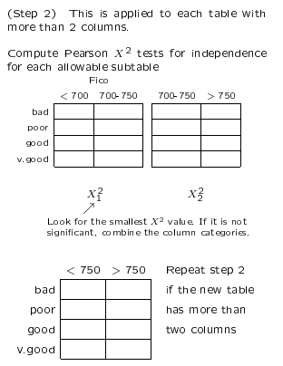
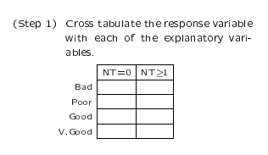
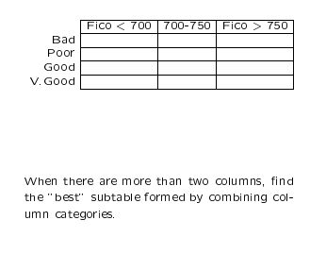
CHAID ALGORITHM
Both IV and DV are categorical variables

Slide 4
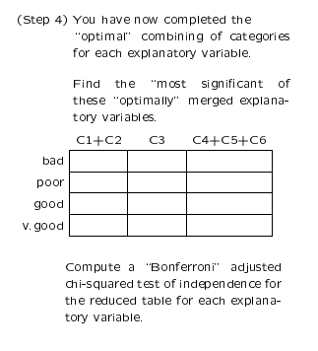
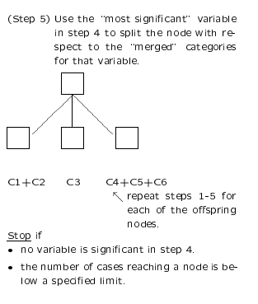
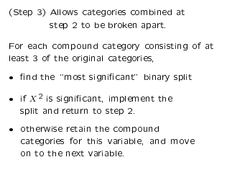
CHAID ALGORITHM

Slide 5
What is CART?
Classification And Regression Trees
Developed by Breiman, Friedman, Olshen, Stone in early 80’s.
Introduced tree-based modeling into the statistical mainstream
Rigorous approach involving cross-validation to select the optimal tree
One of many tree-based modeling techniques.
CART -- the classic
CHAID
C5.0
Software package variants (SAS, S-Plus, R…)
Note: the “rpart” package in “R” is freely available

Slide 6
Splitting Rules
Select the variable value (X=t₁) that produces the greatest “separation” in the target variable.
“Separation” defined in many ways.
Regression Trees (continuous target): use sum of squared errors.
Classification Trees (categorical target): choice of entropy, Gini measure, “twoing” splitting rule.

Slide 7
Regression Trees
Tree-based modeling for continuous target variable
most intuitively appropriate method for loss ratio analysis
Find split that produces greatest separation in
∑[y – E(y)]²
i.e.: find nodes with minimal within variance
and therefore greatest between variance
like credibility theory
Every record in a node is assigned the same yhat
➔ model is a step function

Slide 8
Classification Trees
Tree-based modeling for discrete target variable
In contrast with regression trees, various measures of purity are used
Common measures of purity:
Gini, entropy, “twoing”
Intuition: an ideal retention model would produce nodes that contain either defectors only or non-defectors only
completely pure nodes

Slide 9
More on Splitting Criteria
Gini purity of a node p(1-p)
where p = relative frequency of defectors
Entropy of a node -Σplogp
-[p*log(p) + (1-p)*log(1-p)]
Max entropy/Gini when p=.5
Min entropy/Gini when p=0 or 1
Gini might produce small but pure nodes
The “twoing” rule strikes a balance between purity and creating roughly equal-sized nodes
Note: “twoing” is available in Salford Systems’ CART but not in the “rpart” package in R.

Slide 10
Classification Trees vs. Regression Trees
Splitting Criteria:
Gini, Entropy, Twoing
Goodness of fit measure:
misclassification rates
Prior probabilities and misclassification costs
available as model “tuning parameters”
Splitting Criterion:
sum of squared errors
Goodness of fit:
same measure!
sum of squared errors
No priors or misclassification costs…
… just let it run

Slide 11
Growing & Pruning
One approach: stop growing the tree early.
But how do you know when to stop?
CART: just grow the tree all the way out; then prune back.
Sequentially collapse nodes that result in the smallest change in purity.
“weakest link” pruning.

Slide 12
Cost-Complexity Pruning
Definition: Cost-Complexity Criterion
R_{α}= MC + αL
MC = misclassification rate
Relative to # misclassifications in root node.
L = # leaves (terminal nodes)
You get a credit for lower MC.
But you also get a penalty for more leaves.
Let T₀ be the biggest tree.
Find sub-tree of T_{α} of T₀ that minimizes R_{α}.
Optimal trade-off of accuracy and complexity.

Slide 13
Weakest-Link Pruning
Let’s sequentially collapse nodes that result in the smallest change in purity.
This gives us a nested sequence of trees that are all sub-trees of T₀.
T₀ » T₁ » T₂ » T₃ » … » T_{k} » …
Theorem: the sub-tree T_{α} of T₀ that minimizes R_{α} is in this sequence!
Gives us a simple strategy for finding best tree.
Find the tree in the above sequence that minimizes CV misclassification rate.

Slide 14
What is the Optimal Size?
Note that α is a free parameter in:
R_{α}= MC + αL
1:1 correspondence betw. α and size of tree.
What value of α should we choose?
α=0 ➔ maximum tree T₀ is best.
α=big ➔ You never get past the root node.
Truth lies in the middle.
Use cross-validation to select optimal α (size)

Slide 15
Finding α
Fit 10 trees on the “blue” data.
Test them on the “red” data.
Keep track of mis-classification rates for different values of α.
Now go back to the full dataset and choose the α-tree.

Slide 16
How to Cross-Validate
Grow the tree on all the data: T₀.
Now break the data into 10 equal-size pieces.
10 times: grow a tree on 90% of the data.
Drop the remaining 10% (test data) down the nested trees corresponding to each value of α.
For each α add up errors in all 10 of the test data sets.
Keep track of the α corresponding to lowest test error.
This corresponds to one of the nested trees T_{k}«T₀.

Slide 17
Just Right
Relative error: proportion of CV-test cases misclassified.
According to CV, the 15-node tree is nearly optimal.
In summary: grow the tree all the way out.
Then weakest-link prune back to the 15 node tree.

Slide 18
CART advantages
CART handles missing values automatically
Using “surrogate splits”
Invariant to monotonic transformations of predictive variable
Not sensitive to outliers in predictive variables
Unlike regression
Great way to explore, visualize data

Slide 19
CART Disadvantages
The model is a step function, not a continuous score
So if a tree has 10 nodes, yhat can only take on 10 possible values.
MARS improves this.
Might take a large tree to get good lift
But then hard to interpret
Data gets chopped thinner at each split
Instability of model structure
Correlated variables ➔ random data fluctuations could result in entirely different trees.
CART does a poor job of modeling linear structure

Slide 20
Uses of CART
Building predictive models
Alternative to GLMs, neural nets, etc
Exploratory Data Analysis
Breiman et al: a different view of the data.
You can build a tree on nearly any data set with minimal data preparation.
Which variables are selected first?
Interactions among variables
Take note of cases where CART keeps re-splitting the same variable (suggests linear relationship)
Variable Selection
CART can rank variables
Alternative to stepwise regression

